Slide 1

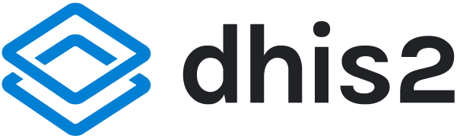

Introduction to
DHIS2 Customization
DHIS2 Customization

Slide 2


Welcome to the
DHIS2 Customization
course
Notes:
Welcome to the DHIS2 Customization course.

Slide 3
What does customization mean in DHIS2?
Notes:
One of the core features of DHIS2 is its customizability. But what does customization mean in the context of DHIS2?

Slide 4
What does customization mean in DHIS2?
Introduction to the concept of DHIS2 customization
Why it is an essential part of DHIS2 implementation
Notes:
In this video, you will get a short introduction to the concept of DHIS2 customization and why it is an essential part of DHIS2 implementation.

Slide 5



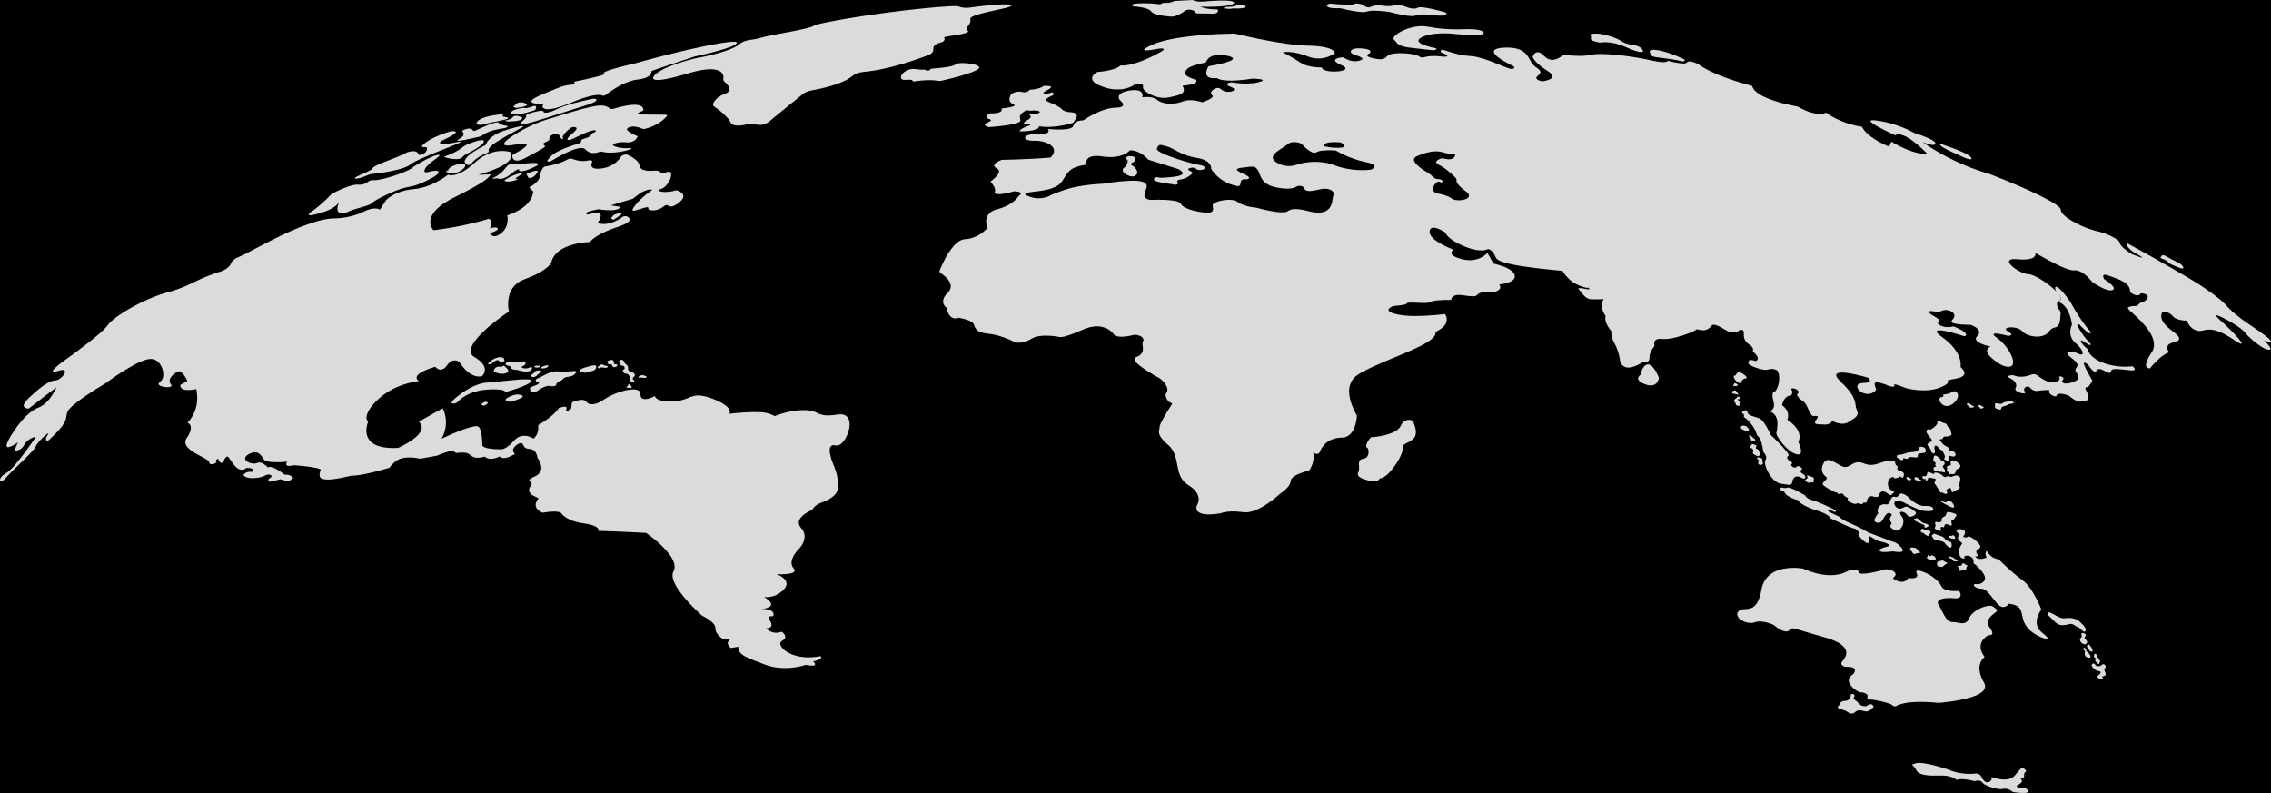
Notes:
DHIS2 is used in more than 100 countries around the world. While the majority of implementations use DHIS2 as a health information system, DHIS2 is also used to collect and manage data in the education sector, such as for school infrastructure and student attendance, as well as for logistics management, human resources, nutrition and sanitation programs, wildlife monitoring, and much more.

Slide 6



Notes:
For example, a health information system can include multiple health programs, such as maternal health, immunization, and malaria control.

Slide 7
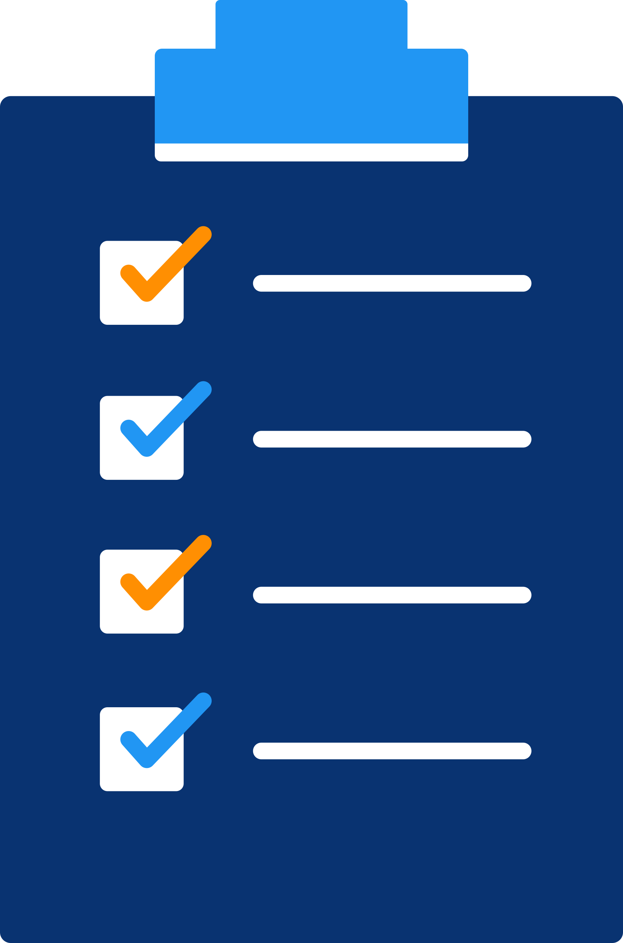
Notes:
Some programs can be managed through collection and analysis of aggregate data while others require data down to the individual level.

Slide 8

Data collection
Notes:
Different countries and contexts allow for different means of data collection, such as on a mobile device or a web browser...

Slide 9
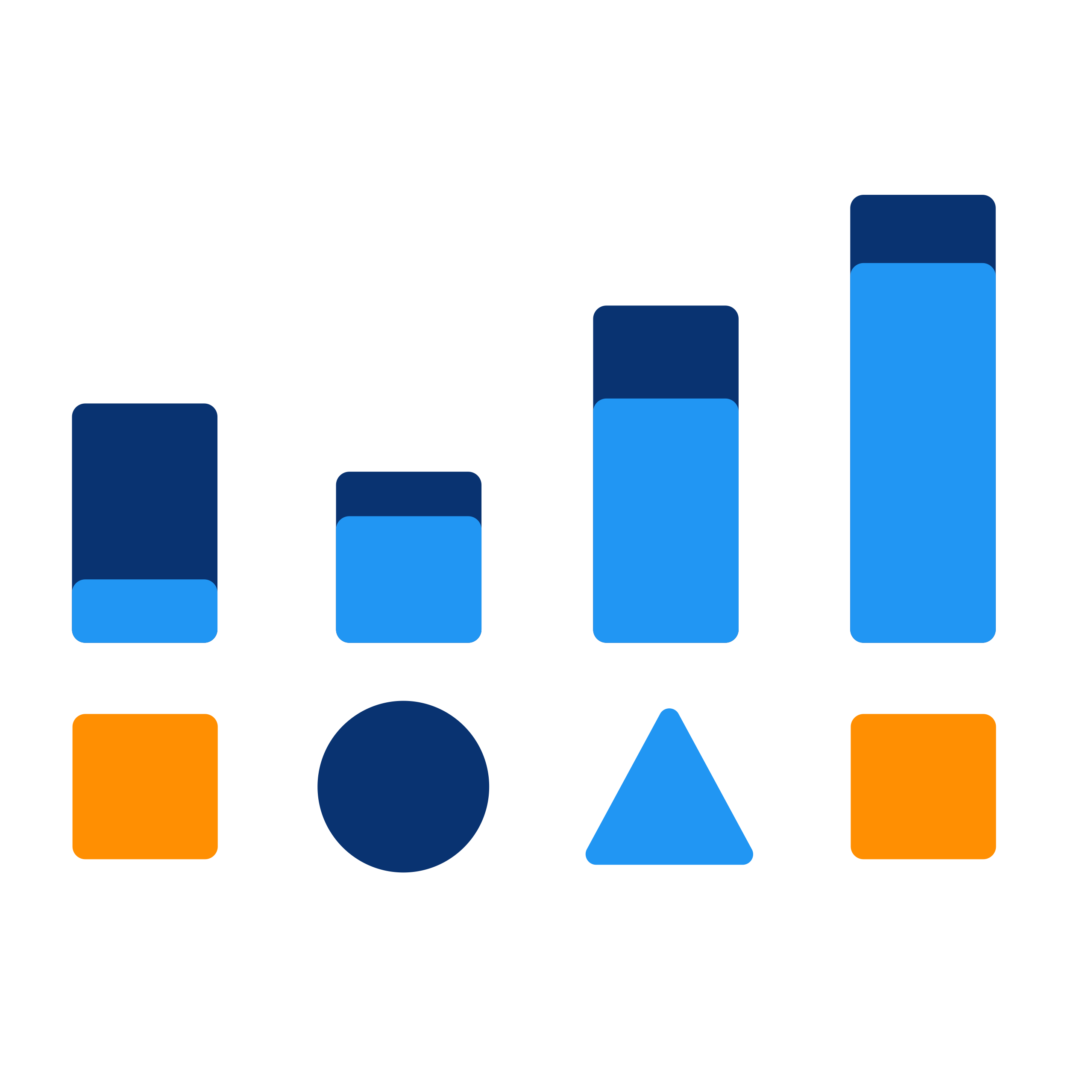
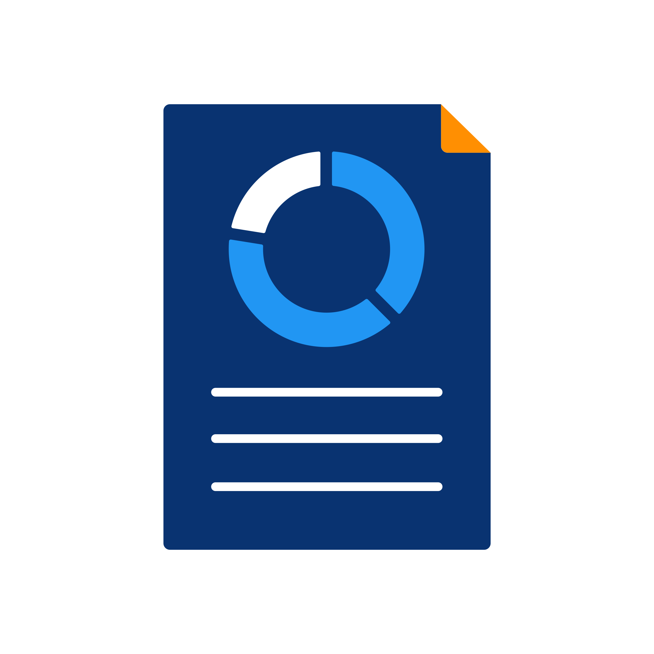
Patient follow-up
Program management
Data analysis
Notes:
... and specific information outputs are required for each context to facilitate tasks such as data analysis, patient follow-up, and program management and evaluation.

Slide 10

Requirements can vary widely from place to place
Notes:
Even in cases where similar programs are being managed across countries, the requirements within these programs can vary widely from place to place.

Slide 11
How is it possible to adapt DHIS2 to work within these various scenarios and meet the needs of diverse use cases?
Notes:
How is it possible to adapt DHIS2 to work within these various scenarios and meet the needs of diverse use cases?

Slide 12
DHIS2: A fully customizable platform
Aggregate and individual level data models
Data entry on desktop or mobile devices
Custom web and Android apps
Integration with other softwares
Notes:
DHIS2 is a flexible, open-source platform that can be customized to meet a wide range of requirements. It supports both aggregate and individual level data models, data entry on desktop and mobile devices, the creation of custom web and Android apps, and integration with other software platforms through open APIs.

Slide 13



Data elements
Periods
Organisation units
Notes:
You can use DHIS2 in any domain where the DHIS2 data model can be applied. As you learned in the introduction to DHIS2 course, this data model is based on capturing data values along three key dimensions, the data element, organization unit, and period.

Slide 14
Data elements
Periods
Organisation units
The system must be customized based on the needs of each specific implementation
Notes:
Because the data model and feature set are purely generic, in other words, DHIS2 is not designed for one particular use case, but to be used for an unlimited variety of use cases. The system must be customized based on the needs of each specific implementation before it can be used.

Slide 15
Data elements
Periods
Organisation units
Notes:
DHIS2 allows you to configure its metadata and structure without the need for programming skills.

Slide 16
DHIS2 Customization
An organisation unit hierarchy
Data elements
Indicators
Data sets & data entry forms
Users
User-based access controls
Notes:
Using the user interface, you are able to create an organization unit hierarchy, including facilities and geographical boundaries, the data elements to collect data values, indicators using these data elements, data sets and customized data entry forms, users, and user-based access controls. There are many other aspects of DHIS2 that can be customized as well.

Slide 17

Each country or organization has full ownership of their DHIS2 database
Notes:
While the core DHIS2 software is developed by the University of Oslo, each country or organization has full ownership of their DHIS2 implementation along with the configuration and data contained within it.

Slide 18
Each country or organization using DHIS2
Suited for the unique context they operate
Customized to meet their requirements
Notes:
This allows each country or organization to have their own customized DHIS2 system that is suited for the unique context they operate in and customized to meet their requirements.

Slide 19
In this course, you wil learn…
DHIS2 Customization
Configuration of metadata
How to create your own organisation unit hierarchies
Set up a simple aggregate data collection tool
Data elements
Data sets
Indicators
Notes:
In this course, you will learn the basics of DHIS2 configuration. This includes how to create your own organization unit hierarchy, the key steps of setting up a simple aggregate data collection tool for a health program, including creating data elements, creating data sets, and creating indicators for data analysis. This will help prepare you to be able to set up a DHIS2 instance to meet your specific needs. We hope you enjoy this course.

Slide 20
We hope you enjoy the course!
Notes:
This will help prepare you to be able to set up a DHIS2 instance to meet your specific needs. We hope you enjoy the course!

